Slide 3
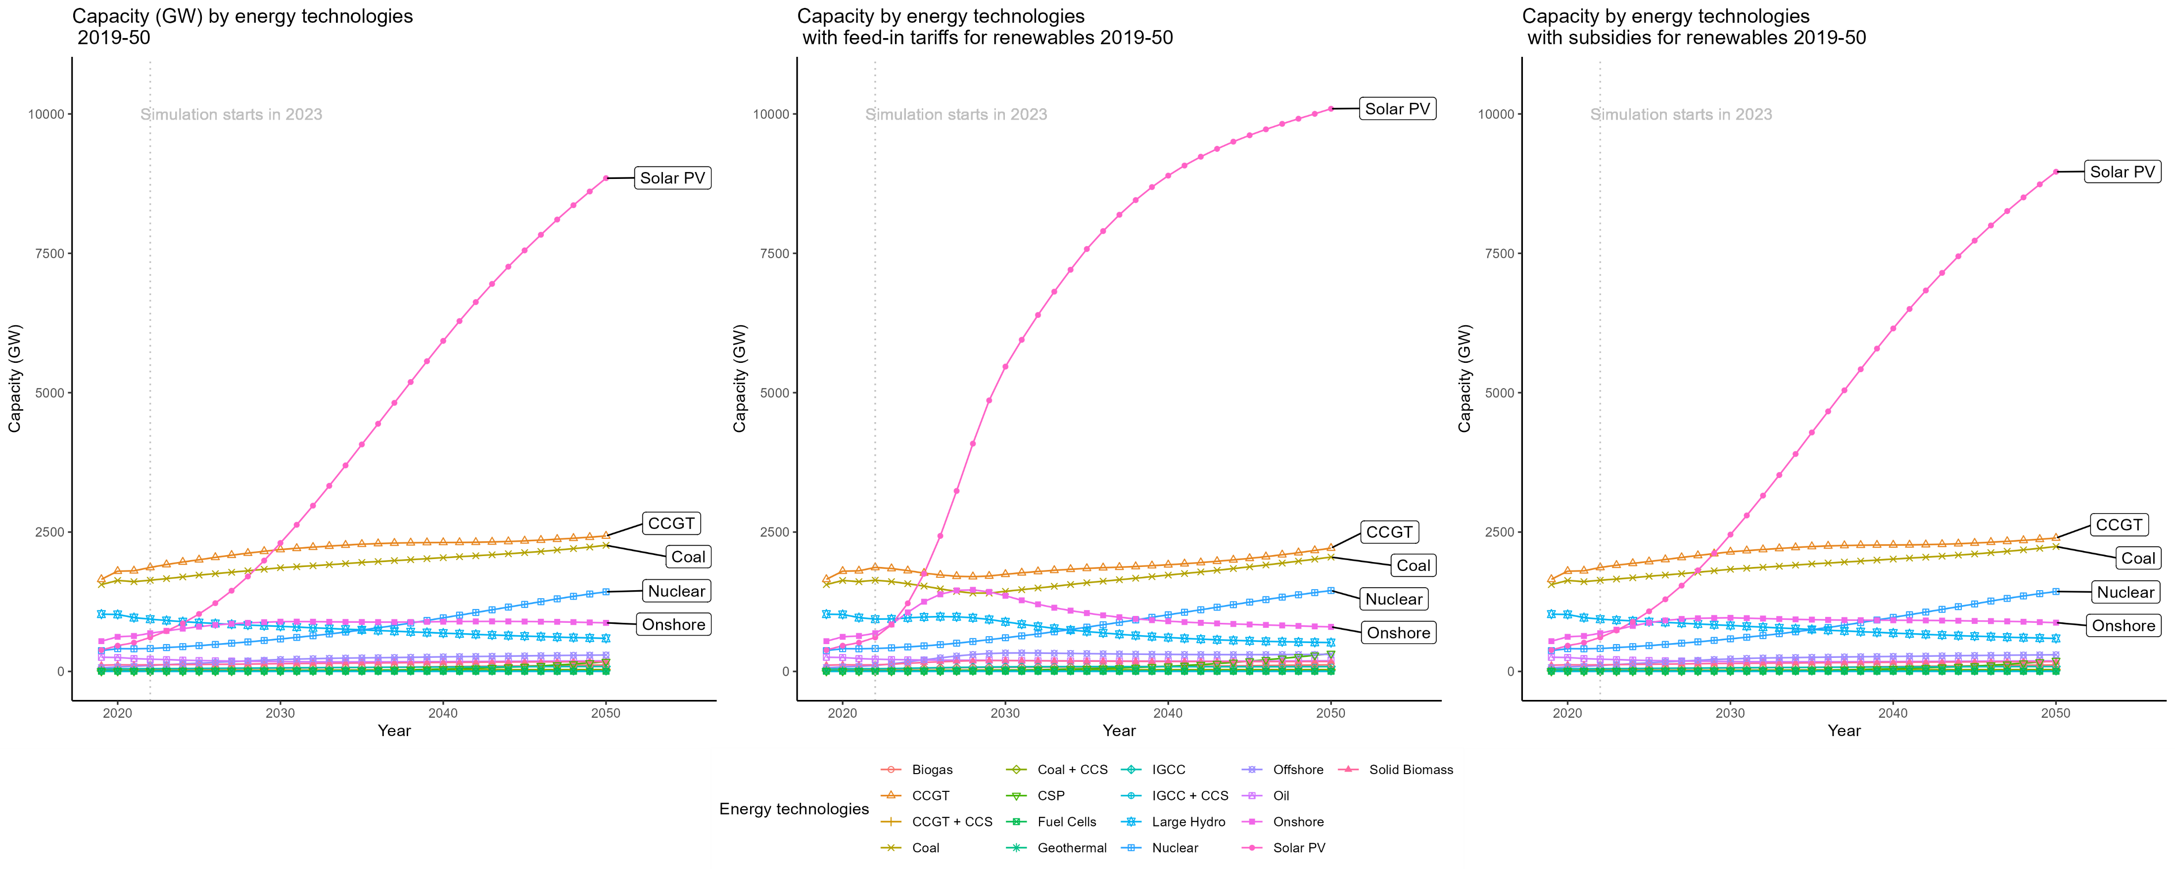

Slide 4
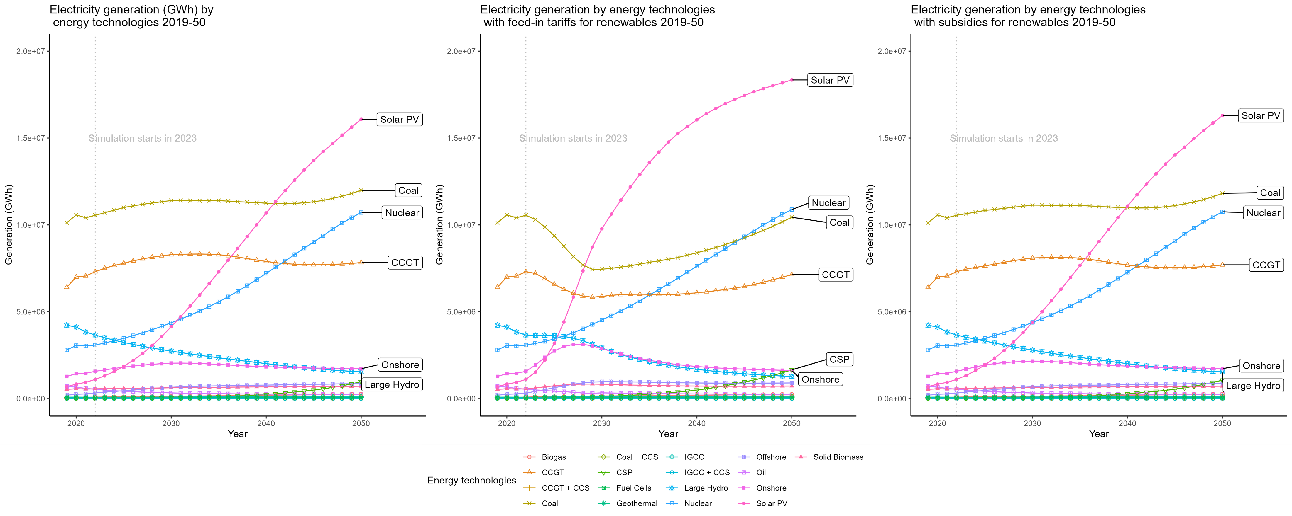

Slide 5
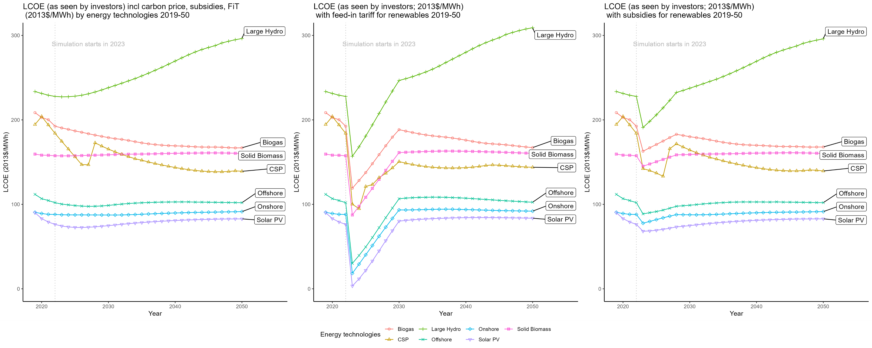
LCOE (as seen by investors) incl carbon price, subsidies, FiT (2013$/MWh) by energy technologies 2019-2050

Slide 6
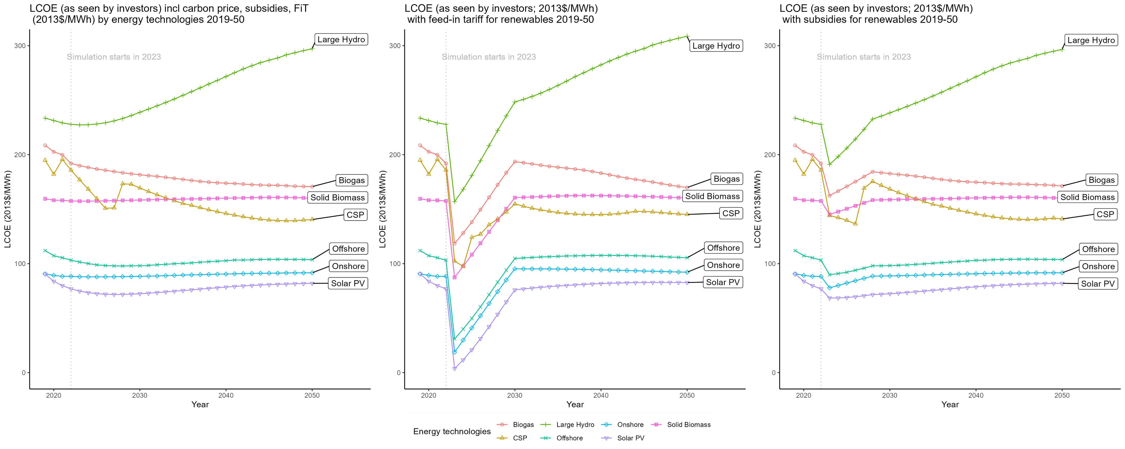

Slide 7
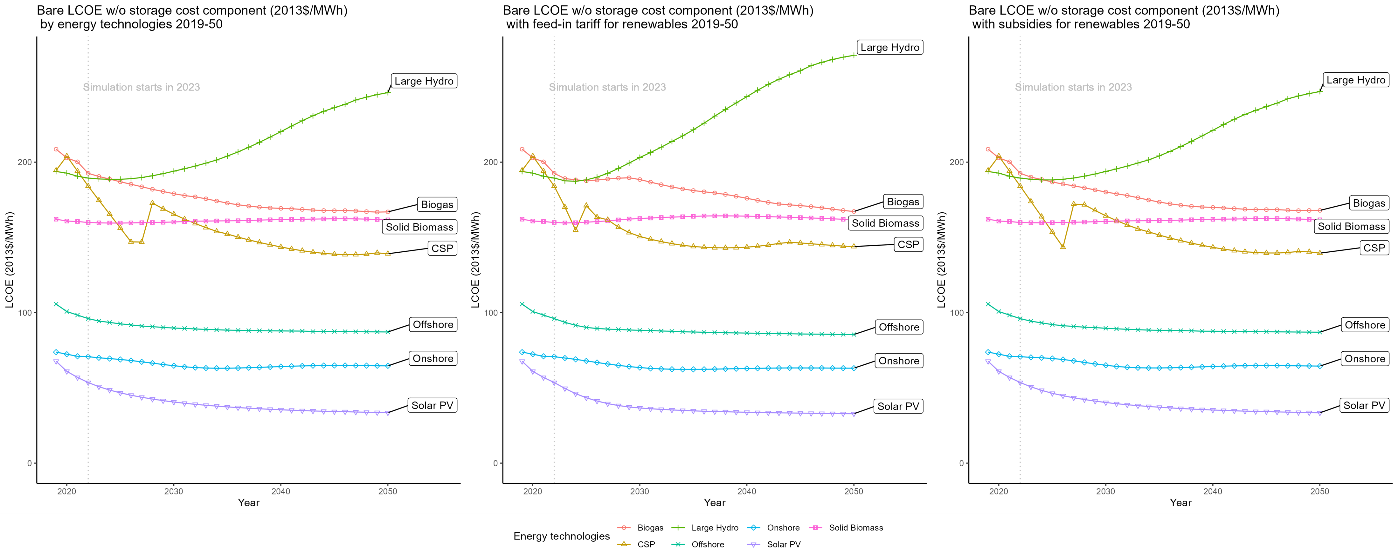
Bare LCOE w/o storage cost component (2013$/MWh)

Slide 8
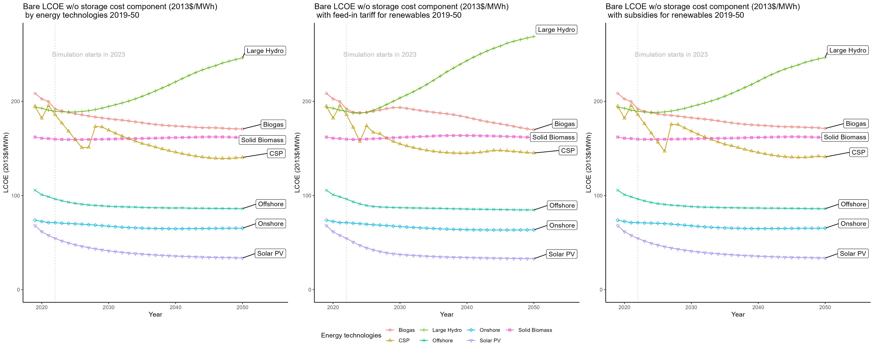

Slide 9
Energy Technologies | IEA 2030 Electrical Capacity (GW) | FTT 2030 Electrical Capacity (GW) | IEA Electrical Capacity (GW) 2050 | FTT Electrical Capacity (GW) 2050 | IEA Share 2030 | FTT Share 2030 | IEA Share 2050 | FTT Share 2050
Total capacity | 14,933 | 9,357 | 33,415 | 17,552 | 100 | 100 | 100 | 100
Renewables | 10,293 | 4,442 | 26,568 | 11,087 | 69 | 47 | 80 | 63
Solar PV | 4,956 | 2,305 | 14,458 | 8,849 | 33 | 25 | 43 | 50
Wind | 3,101 | 1,106 | 8,265 | 1,167 | 21 | 12 | 25 | 7
Hydro | 1,804 | 810 | 2,599 | 594 | 12 | 9 | 8 | 3
Bioenergy | 297 | 199 | 640 | 292 | 2 | 2 | 2 | 2
of which BECCS | 28 | NA | 152 | NA | 0 | NA | 0 | NA
CSP | 73 | 11 | 426 | 175 | 0 | 0 | 1 | 1
Geothermal | 52 | 11 | 126 | 10 | 0 | 0 | 0 | 0
Marine | 11 | NA | 55 | NA | 0 | NA | 0 | NA
Nuclear | 515 | 583 | 812 | 1428 | 3 | 6 | 2 | 8
Hydrogen‐based | 139 | NA | 1,867 | NA | 1 | NA | 6 | NA
Fossil fuels with CCUS | 81 | 42 | 394 | 67 | 1 | 0 | 1 | 0
Coal with CCUS | 53 | 19 | 222 | 34 | 0 | 0 | 1 | 0
Natural gas with CCUS | 28 | 23 | 171 | 33 | 0 | 0 | 1 | 0
Unabated fossil fuels | 3,320 | 4,290 | 677 | 4970 | 22 | 46 | 2 | 28
Coal | 1,192 | 1,861 | 158 | 2262 | 8 | 20 | 0 | 13
Natural gas | 1,950 | 2,251 | 495 | 2518 | 13 | 24 | 1 | 14
Oil | 178 | 178 | 25 | 190 | 1 | 2 | 0 | 1
Battery storage | 585 | NA | 3,097 | NA | 4 | NA | 9 | NA

Slide 10
Energy Technologies | IEA 2030 Generation (TWh) | FTT 2030 Generation (TWh) | IEA 2050 Generation (TWh) | FTT 2050 Generation (TWh) | IEA 2030 Share (%) | FTT 2030 Share (%) | IEA 2050 Share (%) | FTT 2050 Share (%)
Total generation | 37316 | 35101 | 71164 | 54554 | 100 | 100 | 100 | 100
Renewables | 22817 | 10479 | 62333 | 22950 | 61 | 30 | 88 | 42
Solar PV | 6970 | 4139 | 23469 | 16076 | 19 | 12 | 33 | 29
Wind | 8008 | 2701 | 24785 | 2590 | 21 | 8 | 35 | 5
Hydro | 5870 | 2740 | 8461 | 1546 | 16 | 8 | 12 | 3
Bioenergy | 1407 | 763 | 3279 | 979 | 4 | 2 | 5 | 2
of which BECCS | 129 | NA | 842 | NA | 0 | NA | 1 | NA
CSP | 204 | 54 | 1386 | 977 | 1 | 0 | 2 | 2
Geothermal | 330 | 82 | 821 | 782 | 1 | 0 | 1 | 1
Marine | 27 | NA | 132 | NA | 0 | NA | 0 | NA
Nuclear | 3777 | 4370 | 5497 | 10711 | 10 | 12 | 8 | 20
Hydrogen‐based | 875 | NA | 1713 | NA | 2 | NA | 2 | NA
Fossil fuels with CCUS | 459 | 134 | 1332 | 707 | 1 | 0 | 2 | 1
Coal with CCUS | 289 | 86 | 663 | 135 | 1 | 0 | 1 | 0
Natural gas with CCUS | 170 | 48 | 669 | 572 | 0 | 0 | 1 | 1
Unabated fossil fuels | 9358 | 20118 | 259 | 20186 | 25 | 57 | 0 | 37
Coal | 2947 | 11402 | 0 | 11994 | 8 | 32 | 0 | 22
Natural gas | 6222 | 8382 | 253 | 7943 | 17 | 24 | 0 | 15
Oil | 189 | 334 | 6 | 249 | 1 | 1 | 0 | 0

